Slide 1
STI 2018
Prevention of human papillomavirus-related anal cancer
Prof Andrew Grulich
HIV Epidemiology and Prevention Program,
Kirby Institute, UNSW Australia, Sydney
21-22 July 2018

Slide 2
Disclosure
Relations that could be relevant for the meeting | Company names
Sponsorship or refund funds | Sequirus, Gilead, Viiv, Hologic
Payment or other financial remuneration
Shareholder rights | None
Other relations | honoraria for educational presentations from Merck, Gilead and Viiv. advisory board Viiv, Merck

Slide 3
Overview
Anal HPV and anal cancer epidemiology
The natural history of anal high-risk HPV
Interrupting the progression of HR-HPV infection to cancer

Slide 4
Epidemiology/natural history of HPV– the basics
HPV is the most common STI
  The majority of sexually active people will become infected
Mostly, initially no symptoms
  except ano-genital warts caused by low-risk (LR) HPV which very rarely cause cancer
High-risk (HR) HPV infection may cause anogenital and oropharyngeal cancer
  Most HR HPV infection clears within 2 years
  Minority develop high-grade squamous intra-epithelial lesions
  HSIL then progresses to cancer at a rate of about 1/80 per year (cervix)

Slide 5
Anal cancer is highly concentrated in few populations
Population | Relative risk | Annual Incidence (per 100,000)
General population | 1 (referent) | 1-2
Women with previous anogenital HPV disease | 5-20 | 5-20
Organ transplant recipients | 5-10 | 5-20
HIV negative Gay and Bisexual men (GBM) | 5-20 | 5-20
HIV positive people (ex GBM) | 10+ | 10-30
HIV positive GBM | 50 | 70-130

Slide 6
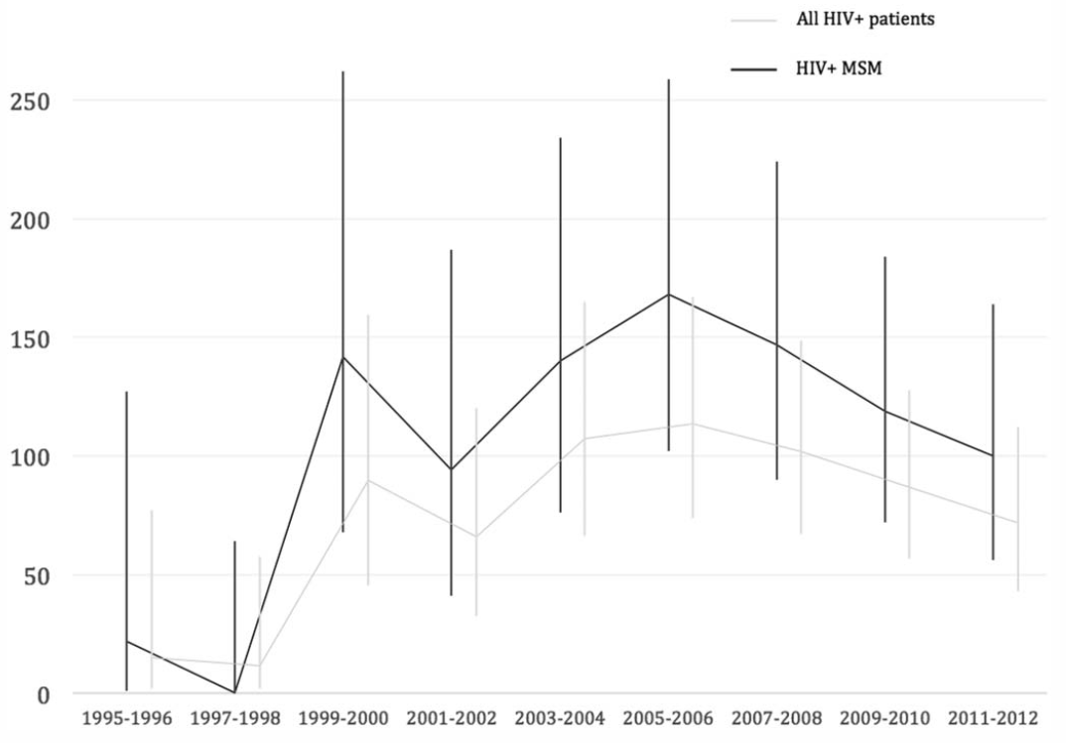
Anal cancer incidence in GBM with HIV, Netherlands
O Richel et al, J AIDS 2015

Slide 7
HPV epidemiology and natural history shapes opportunities for cancer prevention

Slide 8
The natural history of HRHPV – opportunities for intervention
Infection
Progression
Invasion
Normal anus
Anal HRHPV
Anal HSIL
Anal Cancer
Clearance
Regression
HSIL = high-grade squamous intra-epithelial lesions

Slide 9
Intervention 1: HPV vaccination
Primary prevention
HPV vaccination
  Adolescents
  Catch-up in adults (less effective)
Infection
Progression
Invasion
Normal
Anal HRHPV
Anal HSIL
Anal Cancer
Clearance
Regression
HSIL = high-grade squamous intra-epithelial lesions

Slide 10
HPV vaccination
First licensed in 2007
  2-, 4- and 9-valent HPV vaccines now available
RCTS have shown that the vaccines are close to 100% effective in preventing vaccine HPV types in previously uninfected individuals
  Cervix,
  Vulva,
  Anus,
  (Oropharynx)
Prophylactic, not a therapeutic vaccine
  Aimed at 9-12 year olds (prior to onset of sexual activity)

Slide 11
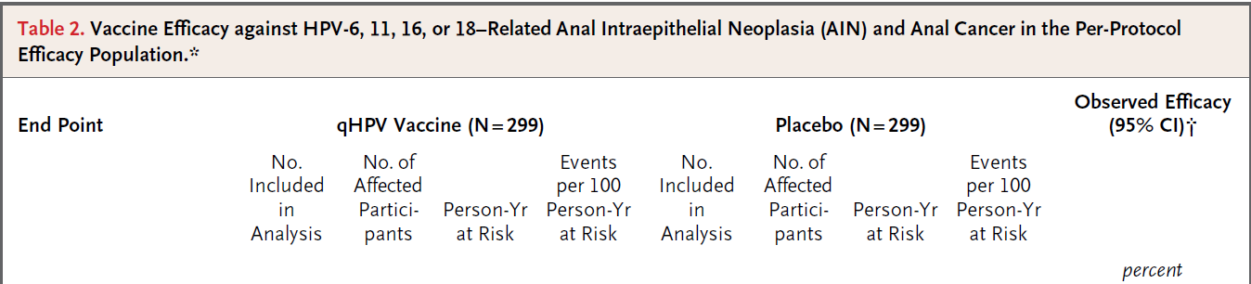
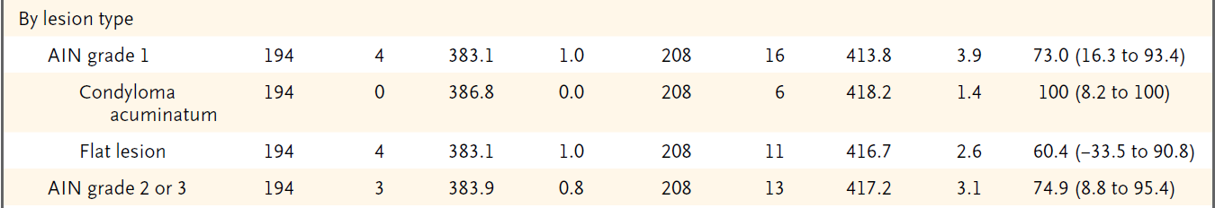
HPV vaccination will prevent anal cancer in the future
Young gay and bisexual men , aged 18-26
J Palefsky et al, NEJM 2011

Slide 12
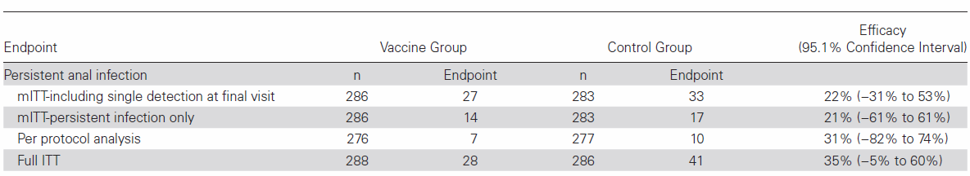
HPV vaccination in adult HIV positive GBM
Safe and immunogenic
ACTG A5298: efficacy trial of the qHPV Vaccine in Older (>26) HIV-infected Adults
  Trial population was majority gay men, also included women
Trial stopped early, borderline significant protective benefit
T Wilkin et al, CID 2018

Slide 13
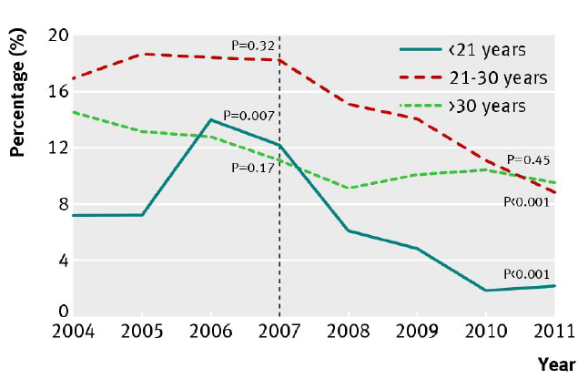
Vaccinating females leads to substantial herd protection from HPV in heterosexual men
Proportion of Australian-born heterosexual men attending sexual health clinics
with genital warts by age group, 2004-2011
-51.1%
-81.8%
H Ali et al, BMJ 2013
Notes:
<21 years: 7.2% in 2004 increase to 12.1% in 2007 and decreased to 2.2% in 2011
21-30 years: 17% in 2004 increase to 18.2% in 2007 and declined to 8.9% in 2011
>30 years: 14.5% in 2004 decreased to 11.1% in 2007 and declined to 9.4% in 2011

Slide 14
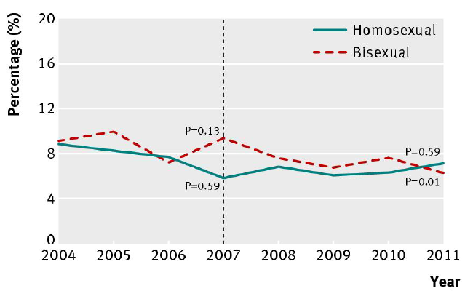
……but not in homosexual men.
We need to vaccinate boys
Proportion of Australian-born GBM attending sexual health clinics
with anogenital warts, 2004-11
H Ali et al, BMJ 2013
Notes:
9% in 2004 and 8.5% in 2007 and 6.4% in 2011
Number of MSM seen at SHS have been increasing over the past decade – so the increase in denominator is diluting the proportion.

Slide 15
Interventions 2: screening and treatment for anal HSIL
Secondary prevention
Screening and treatment for HSIL
ablative or destructive therapies
Investigational therapies
immune modulators
antivirals
therapeutic HPV vaccination
Infection
Progression
Invasion
Normal
Anal HRHPV
Anal HSIL
Anal Cancer
Clearance
Regression
HSIL = high-grade squamous intra-epithelial lesions

Slide 16
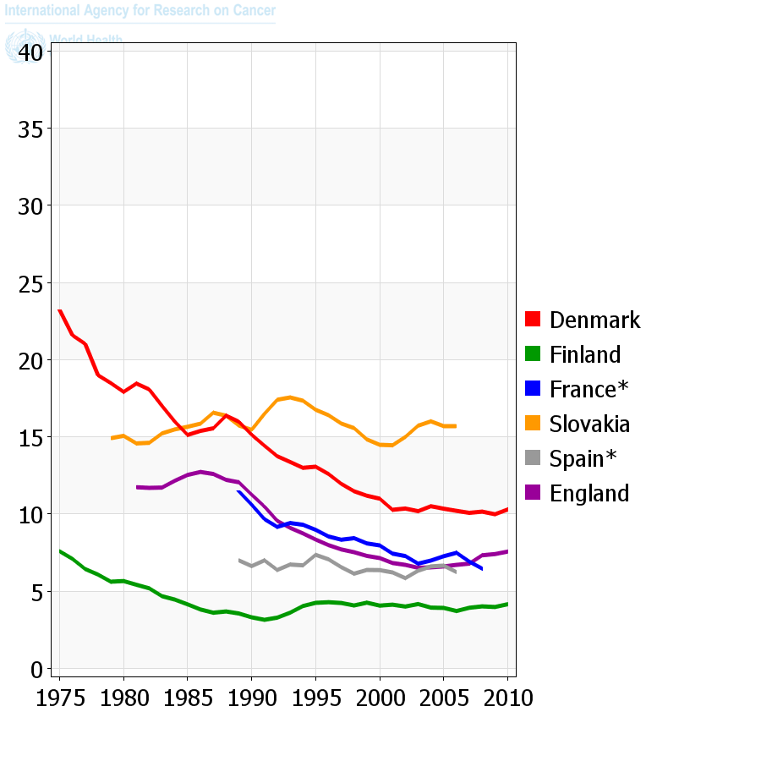
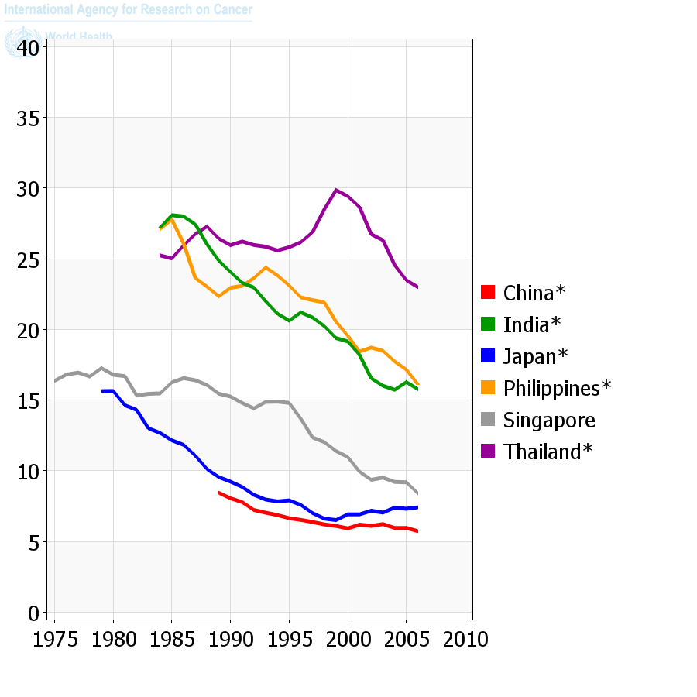
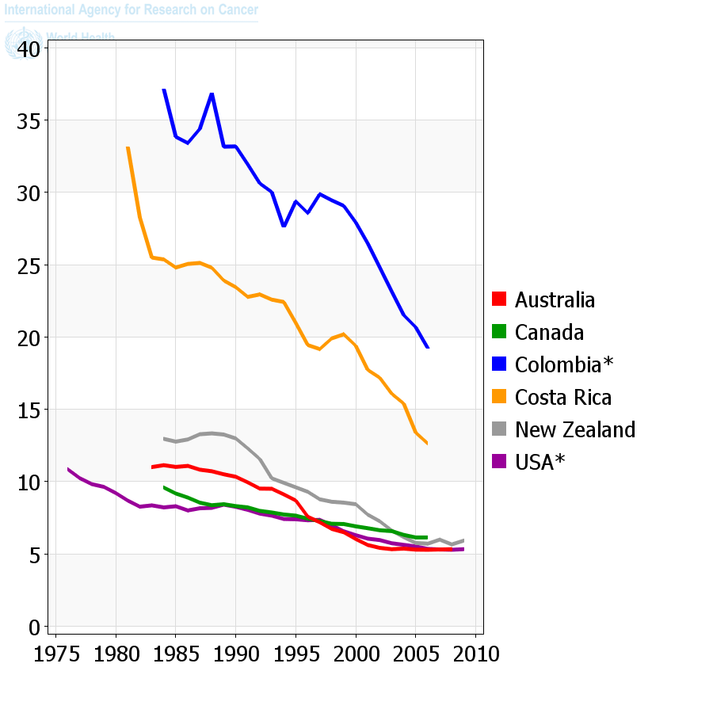
Cervical screening works: declining cancer incidence
Globocan cervical cancer fact sheet

Slide 17
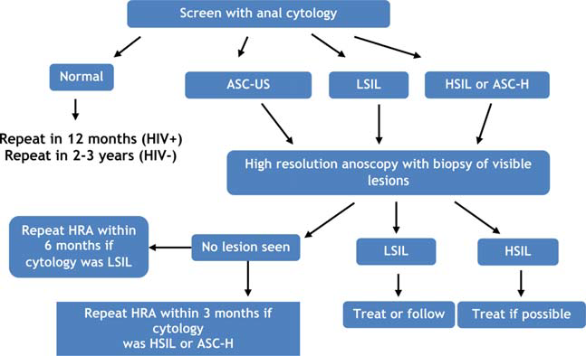
Can we adapt Pap screening for anal cancer prevention?
Not recommended in any national guidelines, but practised in some US/European centres
J Palefsky, Cancer cytopath 2015

Slide 18
The cervical analogy: screening and diagnosis
 | Cervical cancer/HSIL Women, general population
Screening test | Cervical Pap
Diagnostic test | Colposcopy
Threshold for referral for diagnostic test | HSIL/pHSIL LSIL – rescreen 12/12
Sensitivity | Mean 53%
Specificity | Mean 96%
Threshold for treatment | HSIL-CIN2+. Watchful waiting of CIN2 in the young, pregnant

Slide 19
The cervical analogy: screening and diagnosis
 | Cervical cancer/HSIL Women, general population | Anal cancer/HSIL HIV positive gay and bisexual men
Screening test | Cervical Pap | Anal swab
Diagnostic test | Colposcopy | High resolution anoscopy
Threshold for referral for diagnostic test | HSIL/pHSIL LSIL – rescreen 12/12 | Any cytological abnormality
Sensitivity | Mean 53% | 55-87%
Specificity | Mean 96% | 37-76%
Threshold for treatment | HSIL-CIN2+. Watchful waiting of CIN2 in the young | Unclear. ?HSIL-AIN2+ ?watchful waiting

Slide 20
The cervical analogy: HPV screening?
 | Cervix Women, general population
Prevalence of HR HPV | 15%
Incidence of HRHPV | Low at screening ages
Age | Prevalence peaks at <25 (30%), then declines
HR-HPV types in cancer | 100% HR HPV 55% HPV16; 15% HPV18

Slide 21
The cervical analogy: HPV epidemiology
 | Cervix Women, general population | Anus HIV positive gay and bisexual men
Prevalence of HR HPV | 15% | 75%
Incidence of HRHPV | Low at screening ages | Few data but high (>15%/year)
Age | Prevalence peaks at <25 (30%), then declines | Prevalence constant with age, does not decline
HR-HPV types in cancer | 60% HPV16 | 70% HPV16

Slide 22
The cervical analogy: HSIL epidemiology
High grade SIL (CIN2+)
 | Cervical cancer/HSIL Women, general population
Prevalence | 1-2%
Regression | CIN2: 40-50% CIN3: 33%
Progression to cancer | CIN3: about 1 in 80/year

Slide 23
The cervical analogy: HSIL epidemiology
High grade SIL (CIN2+; AIN2+)
 | Cervical HSIL Women, general population | Anal HSIL HIV positive Gay and bisexual men
Prevalence | 1-2% | 30-50%
Regression | CIN2: 40-50% CIN3: 33% | No studies, but very high prevalence suggests regression is probably common
Progression to cancer | CIN3: about 1 in 80/year (cohort data) | AIN2+: 1 in 400-600/year (estimated from cross sectional HSIL prevalence and anal cancer incidence)

Slide 24
The cervical analogy: HSIL treatment
 | Cervical cancer/HSIL Women, general population
Aim of treatment | Removal of lesion and all of the transformation zone to prevent recurrence
Number of treatments for cure | Single (failure rate around 15%)
Early morbidity | Little.
Late morbidity | Some impact on fertility

Slide 25
The cervical analogy: anal HSIL Treatment
 | Cervical cancer/HSIL Women, general population | Anal cancer/HSIL Homosexual men, HIV positive
Aim of treatment | Removal of lesion and all of the transformation zone to prevent recurrence | Destruction of identified lesions Complete removal is not possible
Number of treatments for cure | Single (failure rate around 15%) | Multiple (failure rate around 70%) Ongoing treatment
Early morbidity | Little. | Pain, bleeding. Non-attendance at follow-up.
Late morbidity | Some impact on fertility | Poorly described.

Slide 26
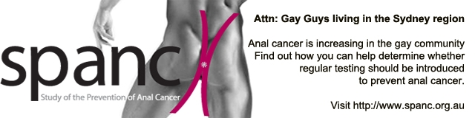
HSIL clearance/persistence
12 months
Baseline
6 months
HSIL-
34
HSIL clearance
21%
HSIL-
44
HSIL+
10
HSIL+
160
HSIL-
27
41%
HSIL+
116
HSIL persistence
56%
HSIL+
89
393 men with complete anal cyto/histo data at
baseline, 6, and 12 months
A Grulich et al, presented at IPV Cape Town, 2017

Slide 27
Does treating HSIL prevent anal cancer?
The ANCHOR study (Prof Joel Palefsky)
Does treating anal HSIL reduce the incidence of anal cancer in HIV-infected men and women?
  A variety of ablative therapies allowed including infrared coagulation, electrocautery, and TCA
US NIH funded
Estimated recruitment > 5000, 5 year follow up
Patients randomly assigned to treatment or active monitoring arms
  followed six monthly for HSIL/cancer for up to 5 years
  estimated completion mid 2022
ClinicalTrials.gov Identifier: NCT02135419

Slide 28
Interventions 3: detect and treat anal cancer early
Tertiary prevention
Screening for cancer
early diagnosis and curative chemo/ radiotherapy
Infection
Progression
Invasion
Normal
Anal HRHPV
Anal HSIL
Anal Cancer
Clearance
Regression
HSIL = high-grade squamous intra-epithelial lesions

Slide 29
Digital anorectal examination (DARE)
Recommended by
  European AIDS clinical society
  US DHHS guidelines on prevention/treatment of opportunistic infections in people with HIV
  Australasian Society for HIV medicine
May substantially advance the stage at which cancer is diagnosed, and thus improve survival and decrease treatment-related morbidity
Simple, easy to learn, but greatly under-practiced
J Ong et al, BMC Cancer 2014

Slide 30
Proven interventions now
Vaccinate!
  All boys and girls prior to onset of sexual activity
  9vHPV vaccination offers some (reduced) benefit in adults
Annual DARE (in HIV positive people) to diagnose anal cancer early and reduce morbidity from cancer treatment
Screening and treatment of HSIL in clinical trial settings.

Slide 31



